Slide 1
From Pixels to Features:
Review of Part 1
COMP 4900C
Winter 2008

Slide 2
Topics in part 1 – from pixels to features
Introduction
  what is computer vision? It’s applications.
Linear Algebra
  vector, matrix, points, linear transformation, eigenvalue, eigenvector, least square methods, singular value decomposition.
Image Formation
  camera lens, pinhole camera, perspective projection.
Camera Model
  coordinate transformation, homogeneous coordinate, intrinsic and extrinsic parameters, projection matrix.
Image Processing
  noise, convolution, filters (average, Gaussian, median).
Image Features
  image derivatives, edge, corner, line (Hough transform), ellipse.

Slide 3
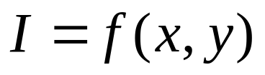
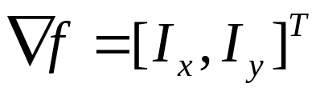
General Methods
Mathematical formulation
  Camera model, noise model
Treat images as functions
Model intensity changes as derivatives
  Approximate derivative with finite difference.
First-order approximation
Parameter fitting – solving an optimization problem

Slide 4
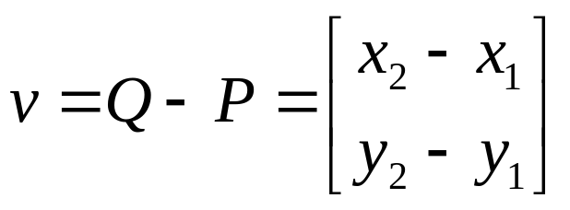
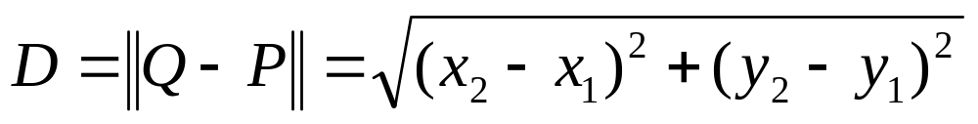
Vectors and Points
We use vectors to represent points in 2 or 3 dimensions
y
v
Q(x2,y2)
P(x1,y1)
x
The distance between the two points:

Slide 5
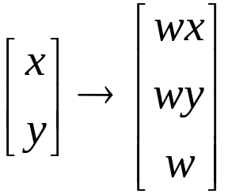
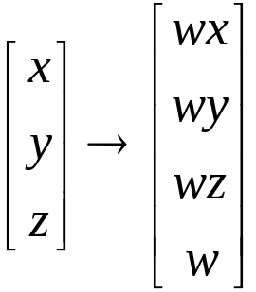

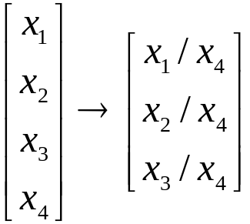
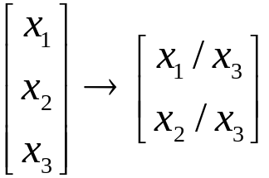
Homogeneous Coordinates
Go one dimensional higher:
is an arbitrary non-zero scalar, usually we choose 1.
From homogeneous coordinates to Cartesian coordinates:

Slide 6
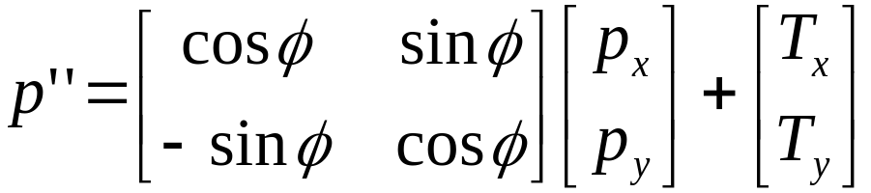
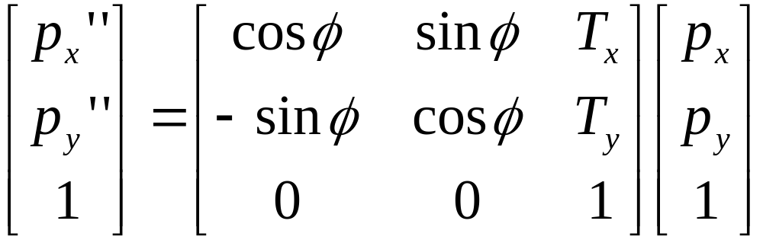
2D Transformation with Homogeneous Coordinates
2D coordinate transformation:
2D coordinate transformation using homogeneous coordinates:

Slide 7


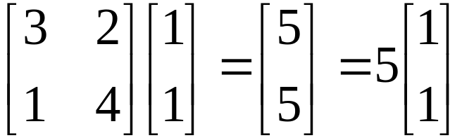
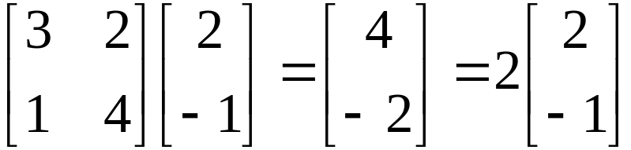

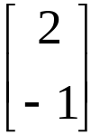
Eigenvalue and Eigenvector
We say that x is an eigenvector of a square matrix A if
λ is called eigenvalue and is called eigenvector.
The transformation defined by A changes only the
magnitude of the vector
Example:
and
5 and 2 are eigenvalues, and
and
are eigenvectors.

Slide 8


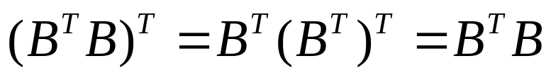
Symmetric Matrix
We say matrix A is symmetric if
Example:
is symmetric for any B, because
A symmetric matrix has to be a square matrix
Properties of symmetric matrix:
  has real eignvalues;
  eigenvectors can be chosen to be orthonormal.
  has positive eigenvalues.

Slide 9


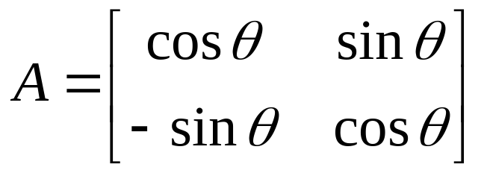
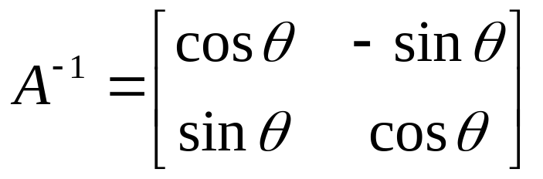
Orthogonal Matrix
A matrix A is orthogonal if
or
The columns of A are orthogonal to each other.
Example:

Slide 10


Least Square
When m>n for an m-by-n matrix A,
has no solution.
In this case, we look for an approximate solution.
We look for vector such that
is as small as possible.
This is the least square solution.

Slide 11


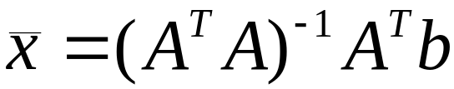
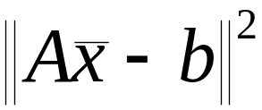
Least Square
Least square solution of linear system of equations
Normal equation:
is square and symmetric
The Least square solution
makes
minimal.

Slide 12

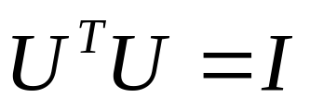
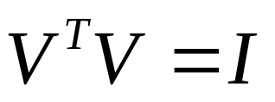
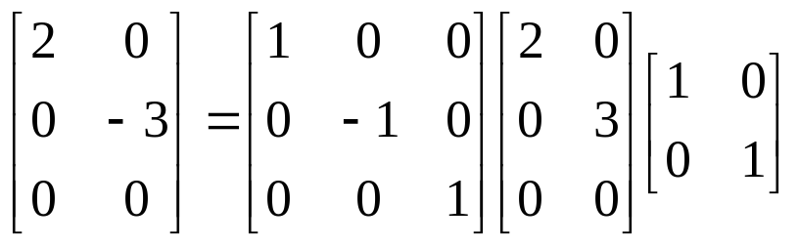
SVD: Singular Value Decomposition
An m×n matrix A can be decomposed into:
U is m×m, V is n×n, both of them have orthogonal columns:
D is an m×n diagonal matrix.
Example:

Slide 13
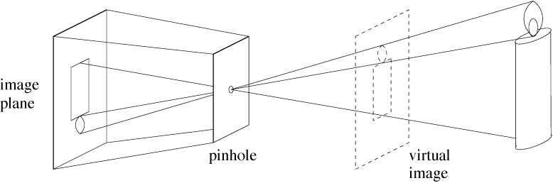
Pinhole Camera

Slide 14
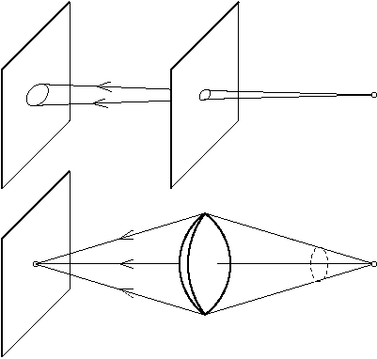
Why Lenses?
Gather more light from each scene point

Slide 15

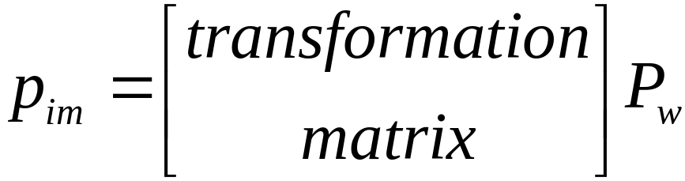
Four Coordinate Frames
Pw
pixel
frame
xim
Zw
Yw
yim
Yc
y
Xc
Xw
camera
frame
world
frame
Zc
image
plane
frame
x
optical
center
principal
point
Camera model:

Slide 16
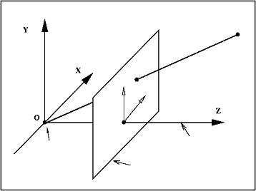
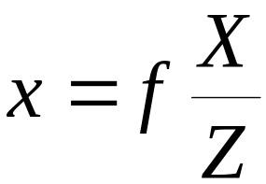
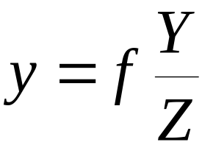
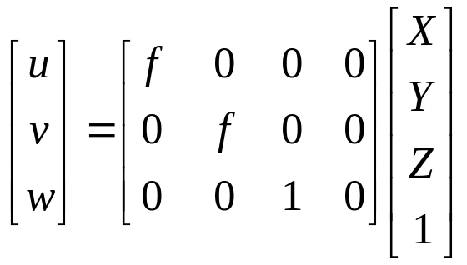


Perspective Projection
P
p
y
x
These are nonlinear.
principal
point
principal
axis
optical
center
image
plane
Using homogenous coordinate, we have a linear relation:

Slide 17

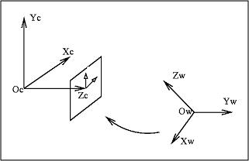
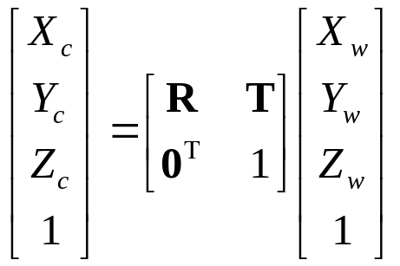
World to Camera Coordinate
Transformation between the camera and world coordinates:
R,T

Slide 18



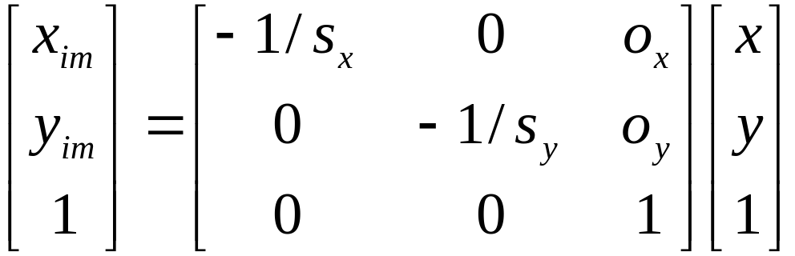
Image Coordinates to Pixel Coordinates
pixel sizes
xim
yim
y
x
(ox,oy)

Slide 19
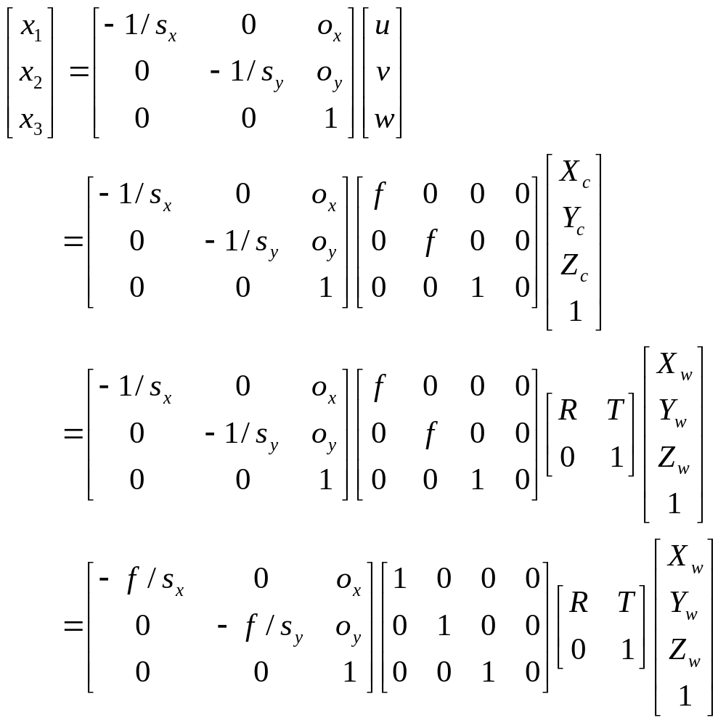
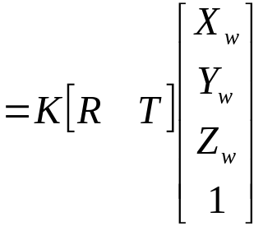


Put All Together – World to Pixel

Slide 20
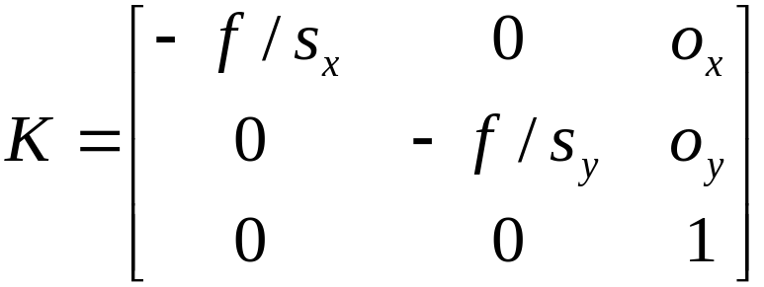


Camera Intrinsic Parameters
K is a 3x3 upper triangular matrix, called the
Camera Calibration Matrix.
There are five intrinsic parameters:
The pixel sizes in x and y directions
The focal length
The principal point (ox,oy), which is the point
where the optic axis intersects the image plane.

Slide 21
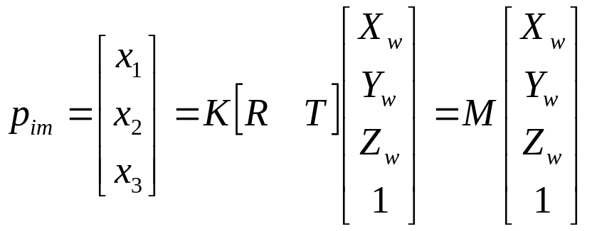
Extrinsic Parameters
[R|T] defines the extrinsic parameters.
The 3x4 matrix M = K[R|T] is called the projection matrix.

Slide 22

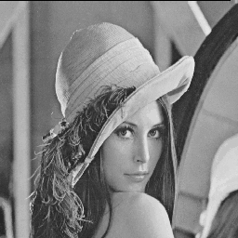
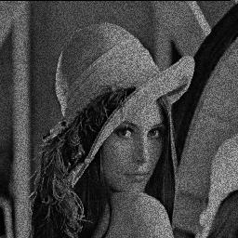
Image Noise
Additive and random noise:
I(x,y) : the true pixel values
n(x,y) : the (random) noise at pixel (x,y)
➔

Slide 23
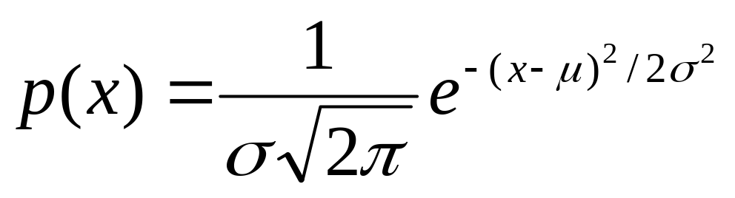
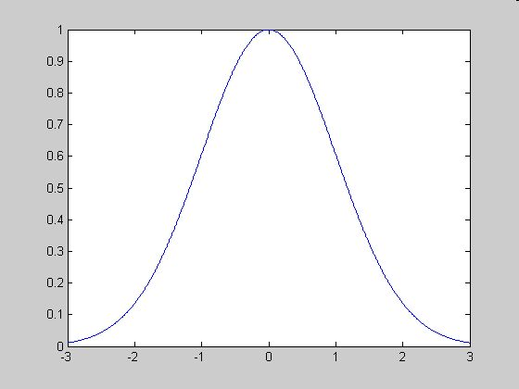
Gaussian Distribution
Single variable

Slide 24

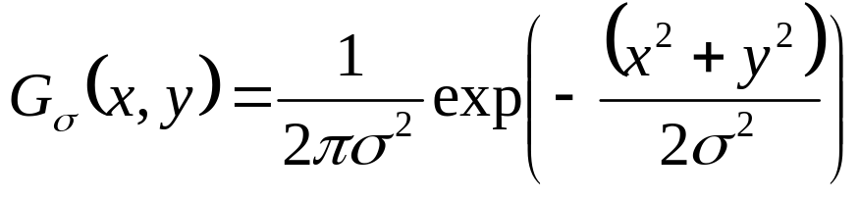
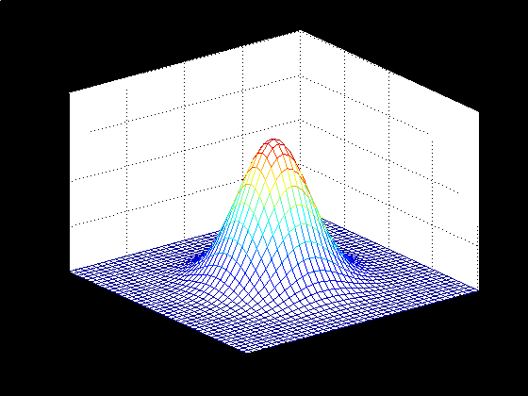
Gaussian Distribution
Bivariate with zero-means and variance

Slide 25
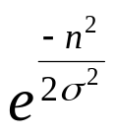
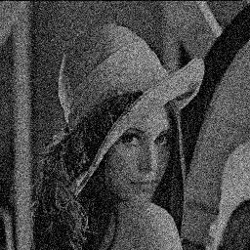
Gaussian Noise
  Is used to model additive random noise
The probability of n(x,y) is
Each has zero mean
The noise at each pixel is independent

Slide 26
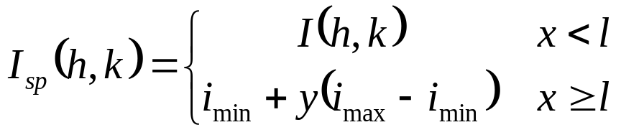
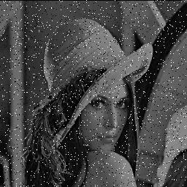
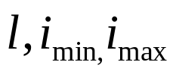
Impulsive Noise
  Alters random pixels
  Makes their values very different from the true ones
Salt-and-Pepper Noise:
  Is used to model impulsive noise
x, y are uniformly distributed random variables
are constants

Slide 27


Image Filtering
Modifying the pixels in an image based on some function of a local neighbourhood of the pixels
N(p)
p
10 | 30 | 10
20 | 11 | 20
11 | 9 | 1
 | 5.7

Slide 28
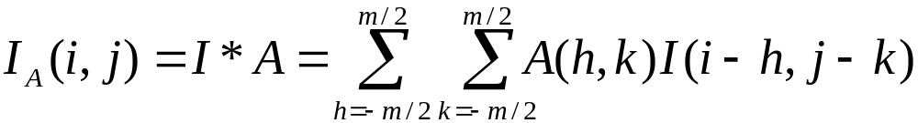

Linear Filtering – convolution
The output is the linear combination of the neighbourhood pixels
The coefficients come from a constant matrix A, called kernel.
This process, denoted by ‘*’, is called (discrete) convolution.
1 | 3 | 0
2 | 10 | 2
4 | 1 | 1
1 | 0 | -1
1 | 0.1 | -1
1 | 0 | -1
 | 5
=
Image
Kernel
Filter Output

Slide 29
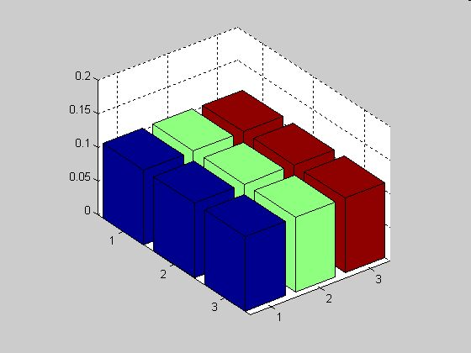
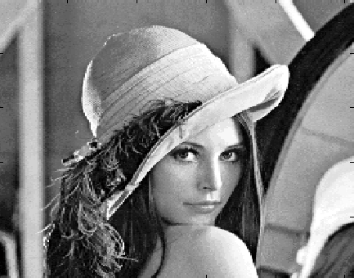
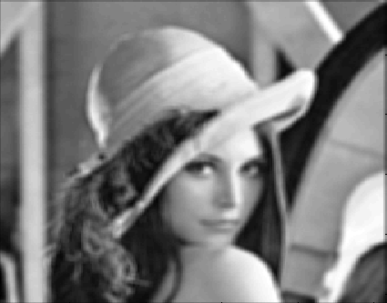


Smoothing by Averaging
1 | 1 | 1
1 | 1 | 1
1 | 1 | 1
Convolution can be understood as weighted averaging.

Slide 30

Gaussian Filter
Discrete Gaussian kernel:

Slide 31





Gaussian Filter

Slide 32


Gaussian Kernel is Separable
since

Slide 33




Gaussian Kernel is Separable
Convolving rows and then columns with a 1-D Gaussian kernel.
I
1
9
18
9
1
=
Ir
1
9
Ir
18
=
result
9
1
The complexity increases linearly with instead of with .

Slide 34

Gaussian vs. Average
Gaussian Smoothing
Smoothing by Averaging

Slide 35

Nonlinear Filtering – median filter
Replace each pixel value I(i, j) with the median of the values
found in a local neighbourhood of (i, j).

Slide 36


Median Filter
Salt-and-pepper noise
After median filtering

Slide 37




Edges in Images
Definition of edges
  Edges are significant local changes of intensity in an image.
  Edges typically occur on the boundary between two different regions in an image.

Slide 38




Images as Functions
2-D
Red channel intensity

Slide 39






Finite Difference – 2D
Continuous function:
Discrete approximation:
Convolution kernels:

Slide 40





Image Derivatives
Image I

Slide 41




Edge Detection using Derivatives
1-D image
1st derivative
threshold
Pixels that pass the
threshold are
edge pixels

Slide 42




Image Gradient
gradient
magnitude
direction

Slide 43





Finite Difference for Gradient
Discrete approximation:
Convolution kernels:
magnitude
aprox. magnitude
direction

Slide 44

Edge Detection Using the Gradient
Properties of the gradient:
  The magnitude of gradient provides information about the strength of the edge
  The direction of gradient is always perpendicular to the direction of the edge
Main idea:
  Compute derivatives in x and y directions
  Find gradient magnitude
  Threshold gradient magnitude

Slide 45





Edge Detection Algorithm
edges
Threshold
Image I

Slide 46



Edge Detection Example

Slide 47




Edge Detection Example

Slide 48

Finite differences responding to noise
Increasing noise ->
(this is zero mean additive gaussian noise)

Slide 49





Solution: smooth first
Where is the edge?
Look for peaks in

Slide 50





Sobel Edge Detector
Approximate derivatives with
central difference
Convolution kernel
Smoothing by adding 3 column
neighbouring differences and give
more weight to the middle one
Convolution kernel for

Slide 51




Sobel Operator Example
*
*
The approximate gradient at

Slide 52
Sobel Edge Detector
edges
Threshold
Image I

Slide 53




Edge Detection Summary
Input: an image I and a threshold τ.
1. Noise smoothing:
(e.g. h is a Gaussian kernel)
2. Compute two gradient images and by convolving
with gradient kernels (e.g. Sobel operator).
3. Estimate the gradient magnitude at each pixel
4. Mark as edges all pixels such that

Slide 54
Corner Feature
Corners are image locations that have large intensity changes
in more than one directions.
Shifting a window in any direction should give a large change in intensity

Slide 55
Harris Detector: Basic Idea
“flat” region:
no change in all directions
“edge”:
no change along the edge direction
“corner”:
significant change in all directions
C.Harris, M.Stephens. “A Combined Corner and Edge Detector”. 1988

Slide 56





Change of Intensity
The intensity change along some direction can be quantified
by sum-of-squared-difference (SSD).

Slide 57



Change Approximation
If u and v are small, by Taylor theorem:
where
therefore

Slide 58


Gradient Variation Matrix
This is a function of ellipse.
Matrix C characterizes how intensity changes
in a certain direction.

Slide 59



Eigenvalue Analysis
If either λ is close to 0, then this is not a corner, so look for locations where both are large.
(λ_{max})^{-1/2}
C is symmetric
C has two positive eigenvalues
(λ_{min})^{-1/2}

Slide 60

Corner Detection Algorithm

Slide 61


Line Detection
The problem:
How many lines?
Find the lines.

Slide 62



Equations for Lines
The slope-intercept equation of line
What happens when the line is vertical? The slope a goes
to infinity.
A better representation – the polar representation
ρ

Slide 63



Hough Transform: line-parameter mapping
A line in the plane maps to a point in the θ-ρ space.
ρ
(θ,ρ)
ρ
All lines passing through a point map to a sinusoidal curve in the
θ-ρ (parameter) space.
ρ

Slide 64

Mapping of points on a line
ρ
Points on the same line define curves in the parameter space
that pass through a single point.
Main idea: transform edge points in x-y plane to curves in the
parameter space. Then find the points in the parameter space
that has many curves passing through.

Slide 65


Quantize Parameter Space
m
m
Detecting Lines by finding maxima / clustering in parameter space.

Slide 66



Examples
input image
Hough space
lines detected
  Image credit: NASA Dryden Research Aircraft Photo Archive

Slide 67
Algorithm
Quantize the parameter space
int P[0, ρmax][0, θmax]; // accumulators
2. For each edge point (x, y) {
For (θ = 0; θ <= θmax; θ = θ+Δθ) {
// round off to integer
(P[ρ][θ])++;
}
}
3. Find the peaks in P[ρ][θ].

Slide 68





Equations of Ellipse
Let
Then

Slide 69







Ellipse Fitting: Problem Statement
Given a set of N image points
find the parameter vector such that the ellipse
fits best in the least square sense:
Where is the distance from to the ellipse.

Slide 70





Euclidean Distance Fit
is the point on the ellipse that
is nearest to
is normal to the ellipse at

Slide 71






Compute Distance Function
Computing the distance function is a constrained optimization
problem:
subject to
Using Lagrange multiplier, define:
where
Then the problem becomes:
Set
we have

Slide 72

Ellipse Fitting with Euclidean Distance
Given a set of N image points
find the parameter vector such that
This problem can be solved by using a numerical nonlinear
optimization system.

